Slide 1

Energy Efficiency Solution
Presenter: Abuzar Patel Project Manager: Adam Innuria
Create an Energy Footprint Model for Sugar Land facility
Make recommendations on energy efficiency upgrades

Slide 2

US Environmental Protection Agency Tool
Energy Portfolio Manager
Benchmarking energy usage
Compare the performance of individual properties in your portfolio
Set Targets/Goals
Metrics
Tracking
Goals

Slide 3
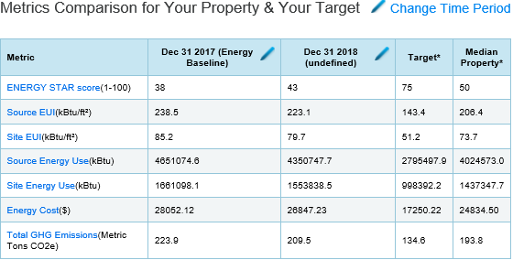
Portfolio Manager
Metrics for Building 105

Slide 4


US Department Of Energy Tool
2. Energy Footprint Tool
Tracks metered energy consumption of a facility (Top-down)
End-use consumption (Bottom-up)
Find gaps between the model and metered data
Resolve any gaps found
Top Down
Bottom Up
Sugar Land Campus
Individual Office Space

Slide 5

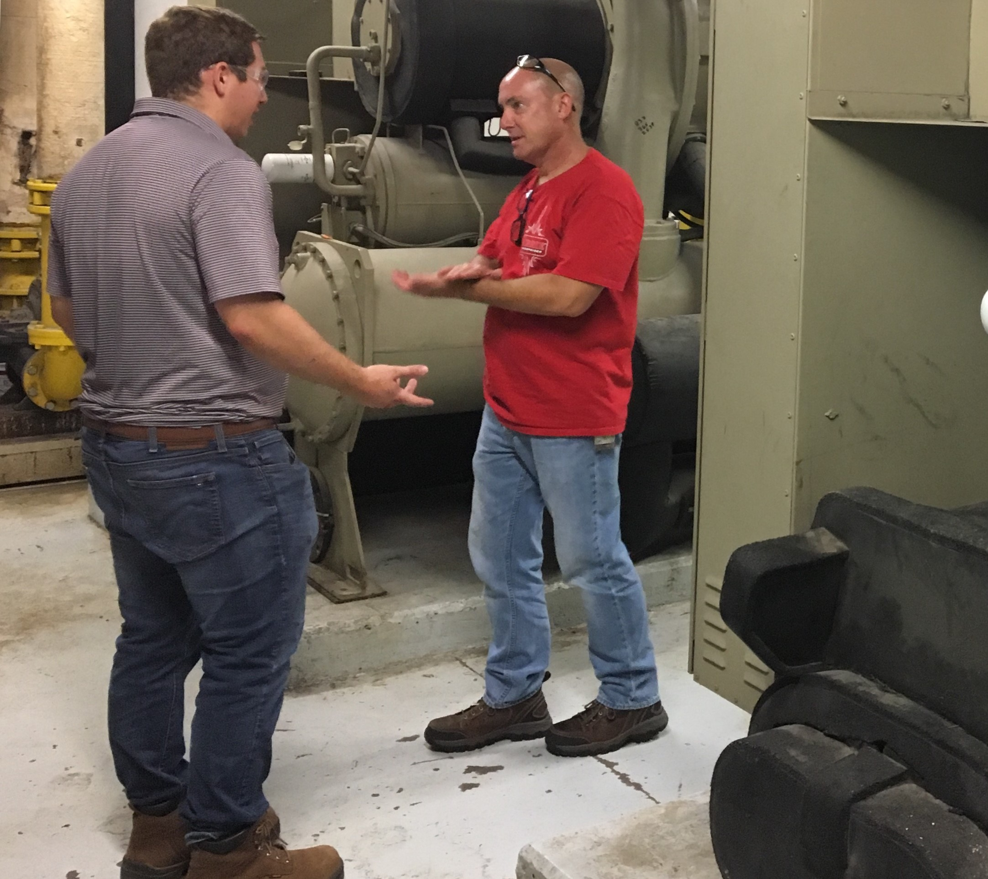
Sugarland Expertise
Henry Lorenzo (Left) & Stuart Walkley (Right)
Adam Inurria (Left) & Randy Meador (Right)

Slide 6
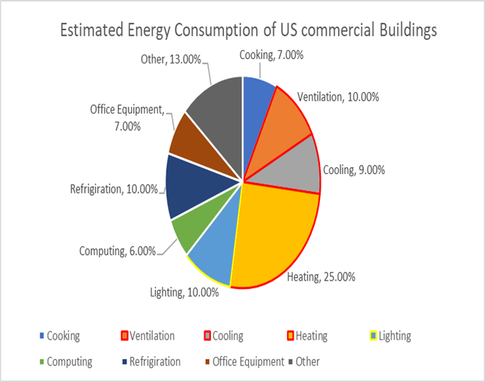
New objective: HVAC Upgrade Project
Align with ongoing Sugarland energy efficiency project in HVAC
Accounts for 44% of energy consumption in US

Slide 7
New objective: HVAC Upgrade Project
Survey
Risk Analysis
Financial Analysis
Assess current HVAC system (Energy Audit)
Analyze results of energy audit for HVAC system
Perform financial analysis

Slide 8
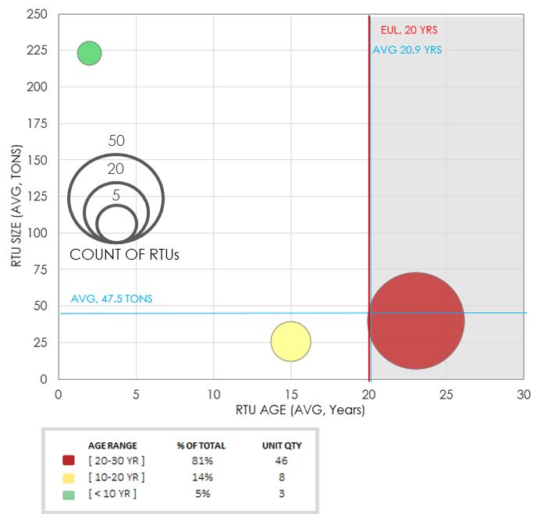
HVAC Asset Risk Assessment
Notes:
What’s the problem?
Most enterprise clients underinvest in their HVAC assets—so average portfolio age is near (or past) useful life of 15 years
Running assets past useful life is an immediate deferred maintenance risk—threatens client capital budget
Furthermore, starting 1/1/2020, the refrigerant R-22 is being banned, which will escalate deferred maintenance risk related to RTUs
Most HVAC units over 10 years old contain R-22
The manufacture / import ban will inhibit traditional maintenance options and speed unit failure rates
In cases where maintenance is still possible, the ban will inflate material and labor pricing

Slide 9
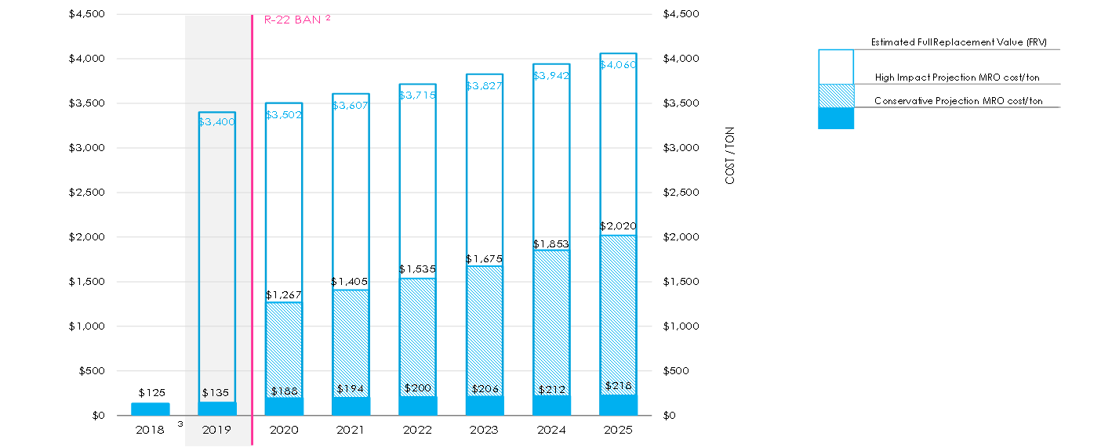
R22 Ban Effect On MRO Cost

Slide 10
Maintenance & Energy Savings
Audits in process to validate Sugar Land asset data, but approximately 30 units in scope for replacement—with a savings opportunity of at least 220K in year 1 (energy and maintenance savings alone).

Slide 11
Financial Solution
On a yearly basis… 15 years
HVAC Cost Savings
HVAC OPEX (lease)

Slide 12
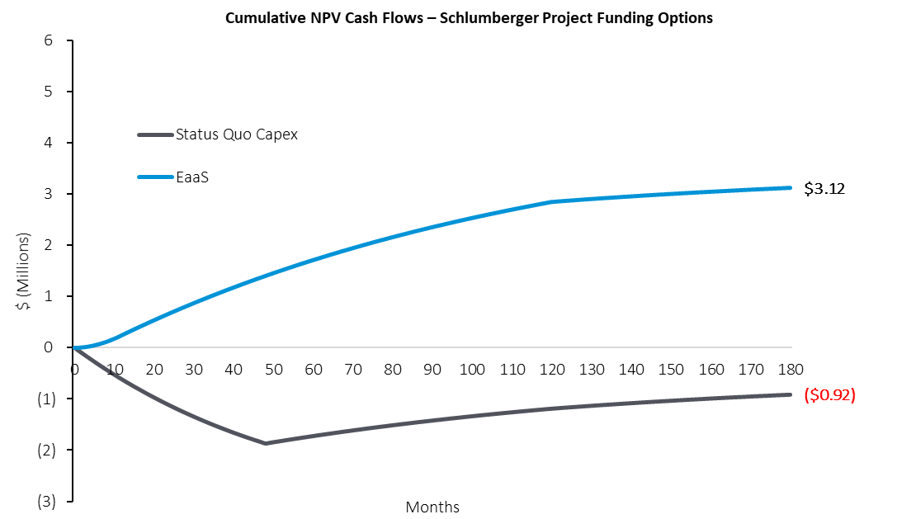
Benefits of 3rd Party Capital
Key assumptions:
EaaS rollout spans 12 months vs. 48 month SLB rollout
20% reduction in HVAC consumption by replacing old equipment with new
100% of recorded maintenance costs are HVAC reactive MRO
Project cost based on original acquisition cost, adjusted for 15 years of inflation
$ (Millions)
Solution
Notes:
Richmond Case Study

Slide 13
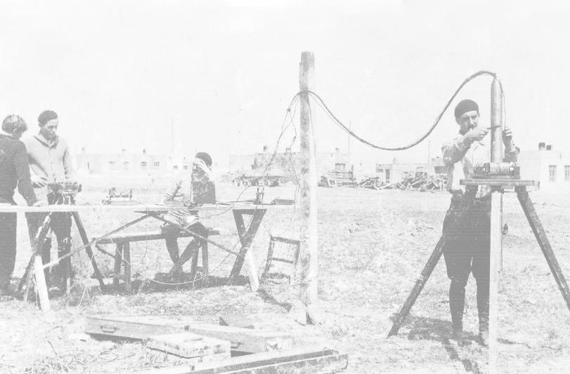
Recommendation
Leverage 3rd Party to deploy energy efficient solution
De-Risking our portfolio
Continued focus on core business
Achieve sustainability goals
Cameron
GeoKnowledge
SPT, Gedco
Nexus Geosciences
Smith International
Geoservices
Techsia
IES
Extreme
Staag
Eastern Echo
Framo Engineering
InnerLogix
VIPS
Geosystem
Insensys
TPG
Reslink
TerraTek
Odegaard
AGO
SGK
PetroAlliance
Voxel Vision
DBR Inc.
Inside Reality
Petrel
Phoenix
Sensa
WesternGeco
Data Marine
IndigoPool.com
CAMCO
Oilphase
IPM
GeoQuest
Prakla-Seismos
Geco
Anadrill
Flopetrol
Dowell
Wireline
1930
1940
1950
1960
1970
1980
1990
2000
2010

Slide 14
Project Assumptions
57 total assets surveyed; 9 buildings with assets recommended for replace; 30 total assets recommended for replace
Savings estimates based on 2017 utility data:
Of annual consumption, HVAC constituted ~35% of total
We estimate asset replacements will reduce that HVAC consumption by ~20%
MRO cost / ton = $125
R22 impact starts in 2020, increases reactive MRO spend by 40%, impact spans 6 years
According to Carrier corporate R-22 ban can escalate up to 300 % in my model we incorporated 140%
1% degradation on the efficiency of the replaced HVAC units per year (Houston)
Additional assumption on Financial slide.

Slide 15
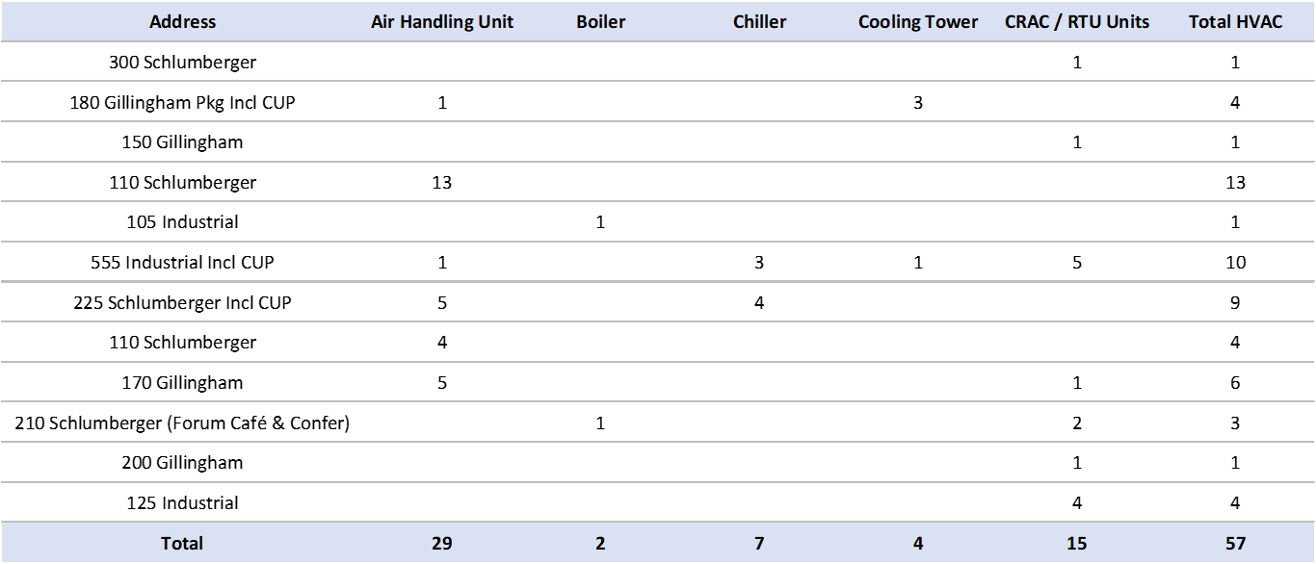
Appendix
$ (Millions)
Solution
Notes:
Richmond Case Study

